Slide 1

#MNSEC2025
Home
Short story
Longer story
Quantum Sunday
-
linkedin.com/in/bayanmunkhb

Slide 2

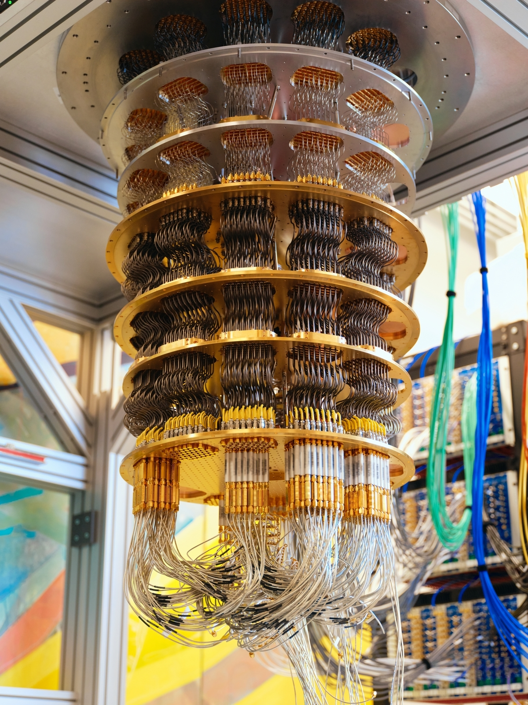
#MNSEC2025
Home
Short story
Longer story
When will Quantum computing threaten us?
NEVER!
15~20 years
5~10 years
ALREADY EXISTS??
#quantumai.google

Slide 3


#MNSEC2025
Home
Short story
Longer story
The short answer is:
We don`t know.
Nobody knows about it .
#quantumai.google
#willow_chip

Slide 4

#MNSEC2025
Home
Short story
Longer story
Longer Story

Slide 5
#MNSEC2025
Home
Short story
Longer story
First, a bit about me
  Bachelor of CS in Computer systems security
  10+ years of experience (8 years in PKI)
  OSCP, OSWE and other certs...
#trustmebro

Slide 6



#MNSEC2025
Home
Short story
Longer story
We will talk about cryptography
  Symmetric algorithm
(Shared key~ One session key)
  Asymmetric algorithm
(Public and Private key ~ Two keys)
#Cryptography

Slide 7
#MNSEC2025
Home
Short story
Longer story
Capable quantum computers will impact cryptography systems
Cryptographhic Function | Primary Algorithms | QC Attack | Impact
Data Encryption | Symmetric (AES, DES) | Grover | Weakened
Key Exchange Digital Signature | Asymmetric (RSA, DH, ECC) | Shor | Broken
#Grover`s algorithm
#Shor`s algorithm

Slide 8

#MNSEC2025
Home
Short story
Longer story
Shor`s algorithm threatens
  SSL/TLS
  OpenPGP, S/MIME
  VPN
  PKI (Digital Signature)
  SSH
  Blockchain and Cryptocurrency ...
#Shor`s algorithm

Slide 9
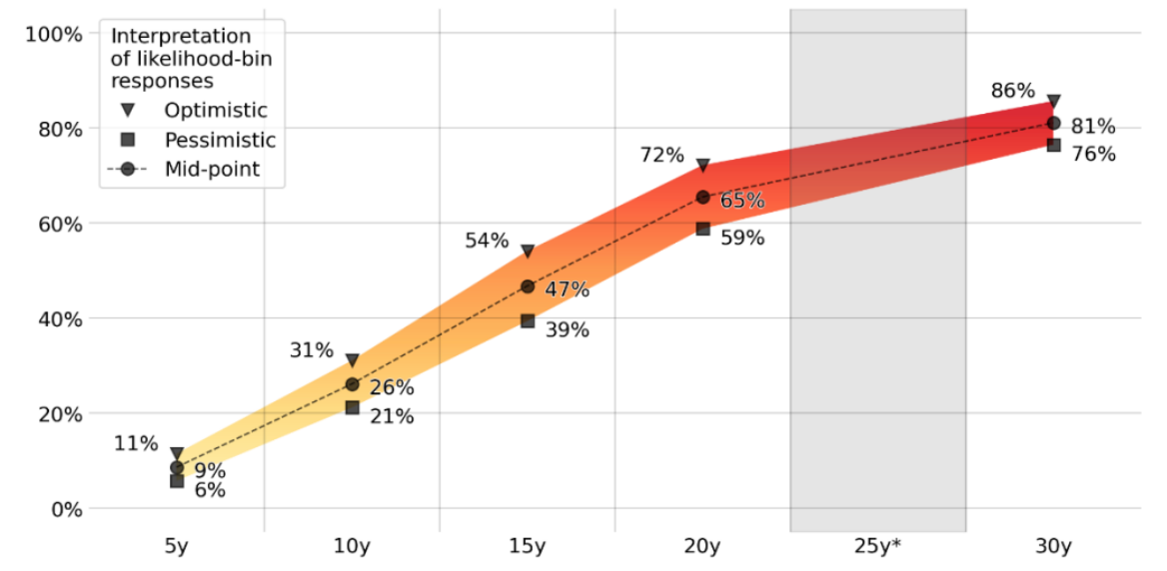
#MNSEC2025
Home
Short story
Longer story
Best estimates...
“2024 opinion-based estimates of the cumulative probability of a digital quantum computer able to break RSA-2048 in 24 hours, as function of timeframe”
#Quantum Threat Timeline Report 2024
#Global Risk Institute

Slide 10
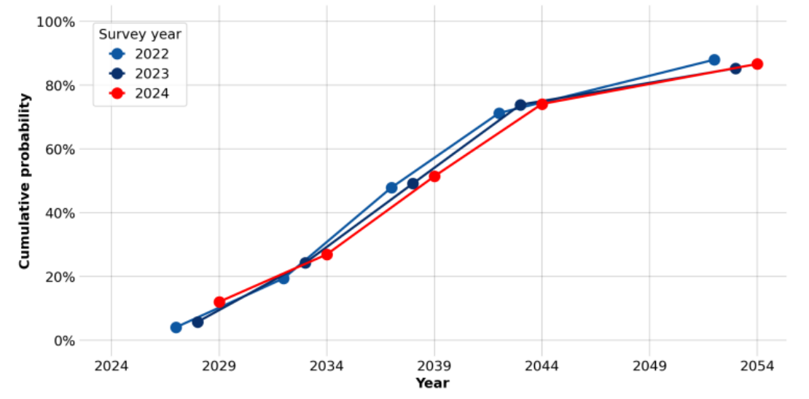
#MNSEC2025
Home
Short story
Longer story
Best estimates...
...digital quantum computer able to break RSA-2048 in 24 hours, as function of timeframe for a stable subset of respondents since 2022
#Quantum Threat Timeline Report 2024
#Global Risk Institute

Slide 11

#MNSEC2025
Home
Short story
Longer story
Why do we need to prepare for it?
Mosca`s theorem
Migration time
Security shelf life
Threat timeline
timeline
if + > , then worry
#Mosca`s theorem

Slide 12
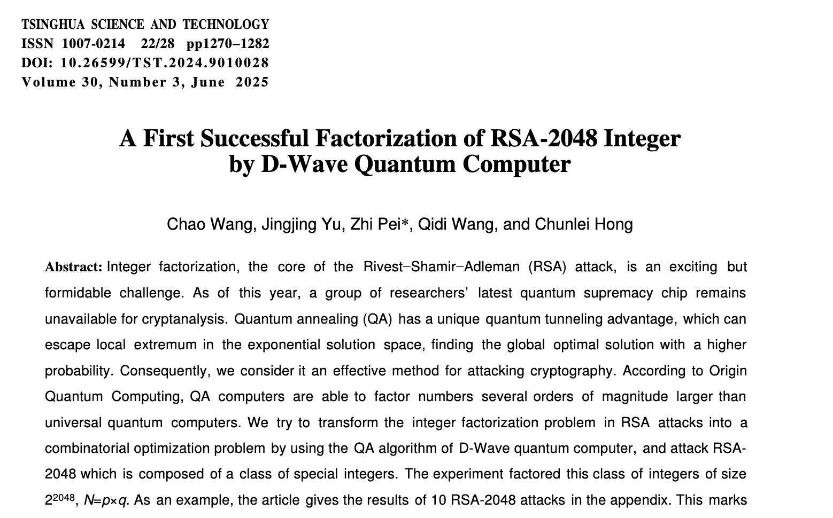
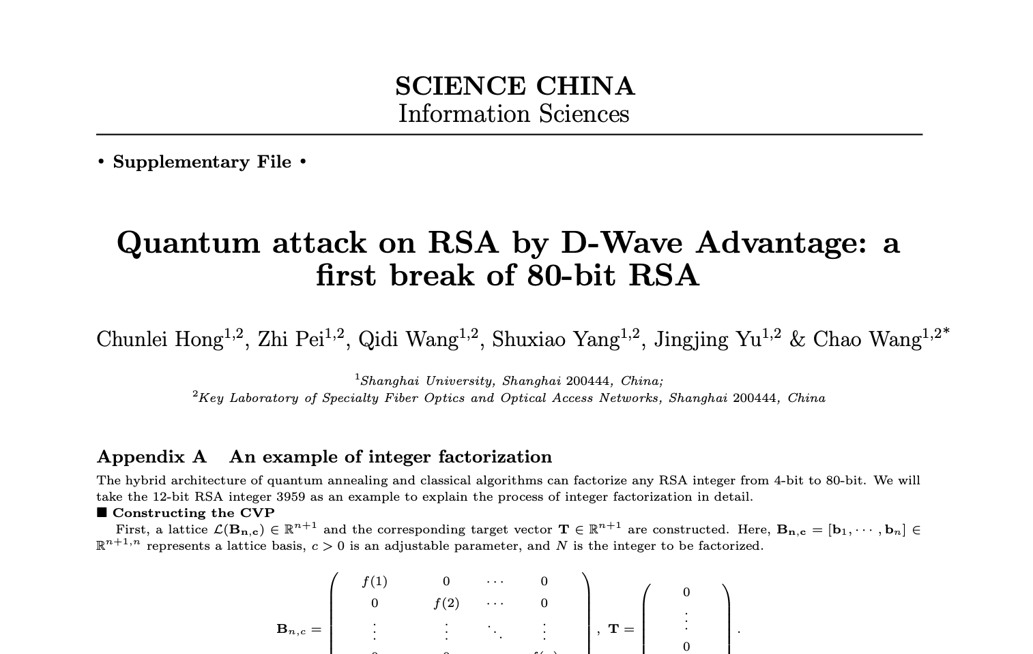
#MNSEC2025
Home
Short story
Longer story
Recent news #1
Chinese researchers break RSA encryption with a quantum computer.
https://static-content.springer.com/esm/art%3A10.1007%2Fs11432-024-4163-6/MediaObjects/11432_2024_4163_MOESM1_ESM.pdf
https://www.researchgate.net/publication/392286850_A_First_Successful_Factorization_of_RSA-2048_Integer_by_D-Wave_Quantum_Computer
#Chao Wang
#Chinese research break RSA

Slide 13
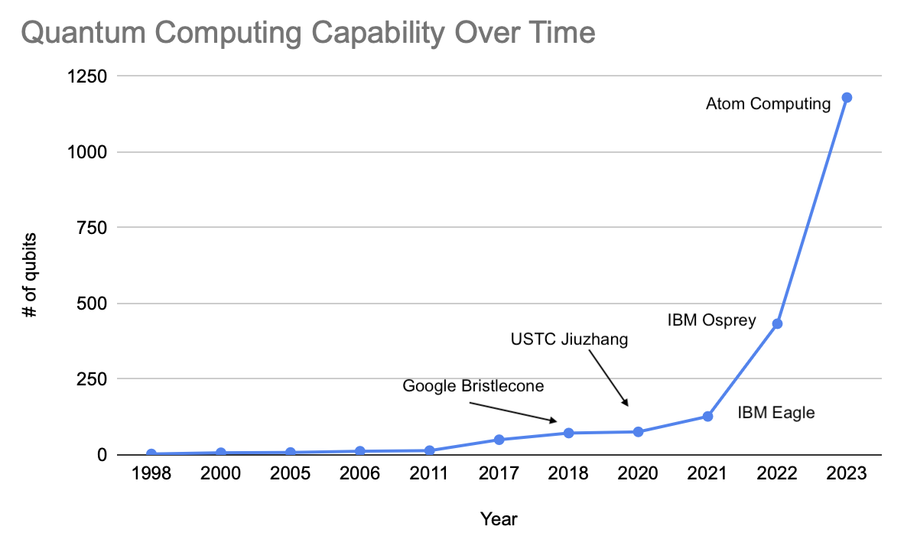
#MNSEC2025
Home
Short story
Longer story
Recent news #2
Latest quantum computers` qubit count.
#Quantum computing capability
#netmeister.org

Slide 14
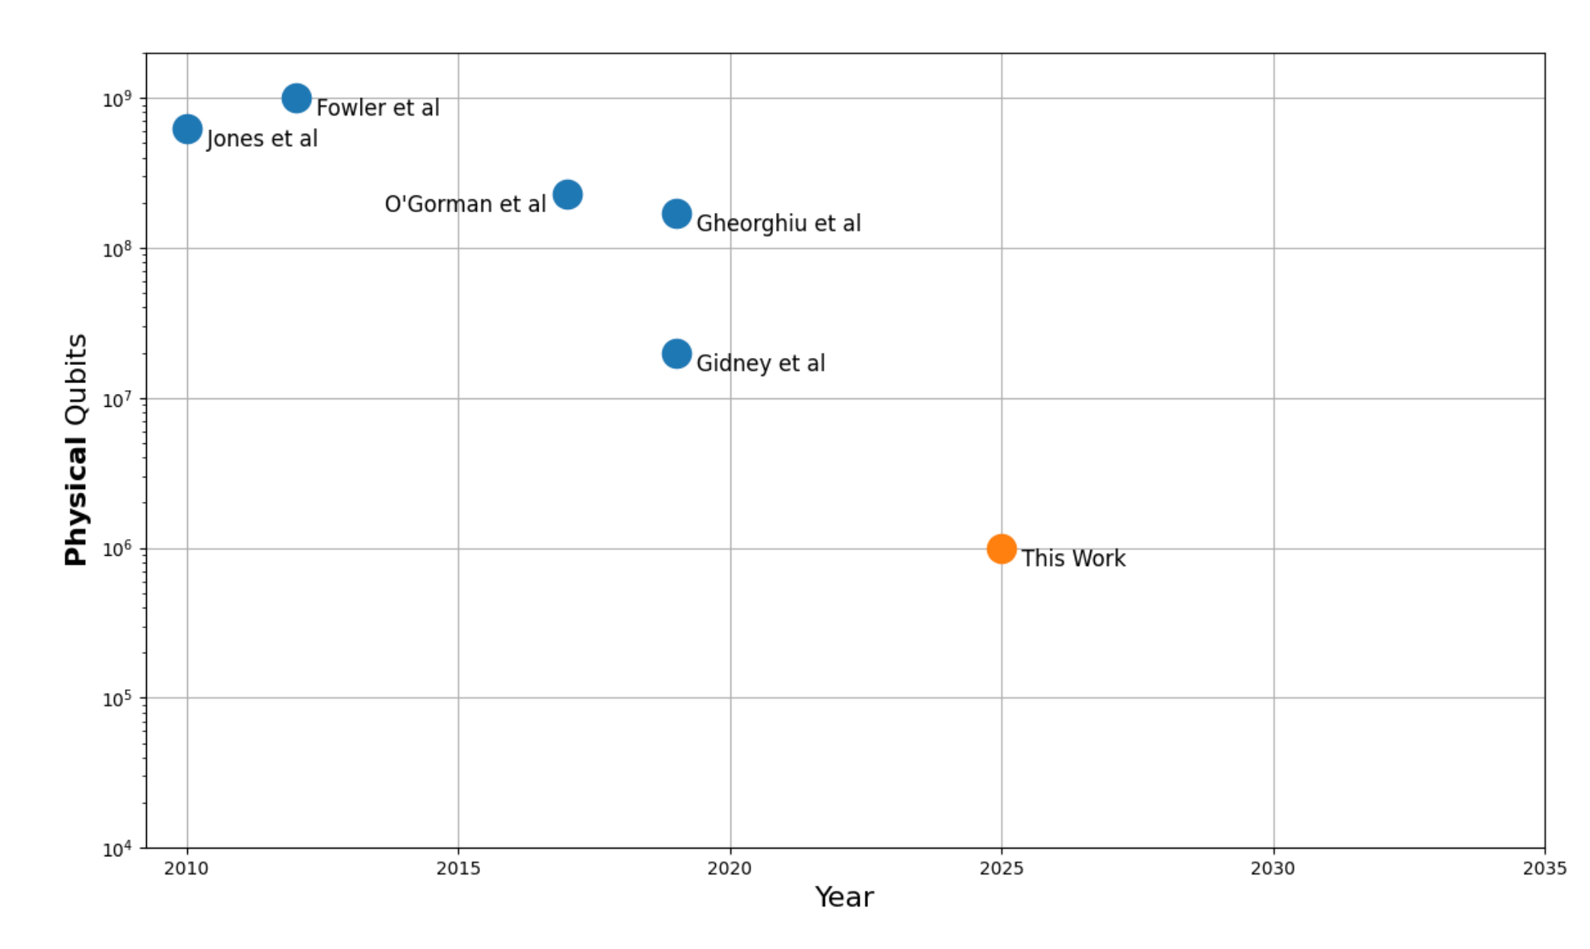
#MNSEC2025
Home
Short story
Longer story
Recent news #3
How many qubits are needed to break RSA 2048?
A Google engineer said: less than 1m noisy qubits. (May, 2025)
#Craig Gidney
#arxiv.org/abs/1905.09749

Slide 15
#MNSEC2025
Home
Short story
Longer story
Q-day, Y2Q day
Quantum technology is expected to reach the maturity enough to be a valid threat against currently in-use cryptography on:
14th April 2030
(it`s a Sunday)
04 years, 6 months, 19 days
#cloudsecurityalliance.org

Slide 16

#MNSEC2025
Home
Short story
Longer story
Q-day, Y2Q day
Quantum technology is expected to reach the maturity enough to be a valid threat against currently in-use cryptography on:
14th April 2030
(it`s a Sunday)
Bidnii hairt crypto
04 years, 6 months, 19 days
#cloudsecurityalliance.org

Slide 17
#MNSEC2025
Home
Short story
Longer story
Future: Quantum resistant techniques
  Quantum Key Distribution (QKD)
  Post Quantum Cryptography (PQC)
uses quantum mechanics
uses classical algorithm
While both PQC and QKD have their strengths, PQC currently stands out as the more practical and reliable option.
#Quantum Key Distribution
#Post Quantum Cryptography

Slide 18
#MNSEC2025
Home
Short story
Longer story
What is Post Quantum Cryptography
Quantum-resistant cryptography, also known as post-quantum cryptography or quantum-safe cryptography, refers to cryptographic algorithms designed to be resistant to attacks by quantum computers. These algorithms are based on mathematical problems that are believed to be computationally difficult for both classical and quantum computers.
#post quantum cryptography

Slide 19
#MNSEC2025
Home
Short story
Longer story
NIST PQC standardization milestones
2016
2017
2023
2024
NIST announcemeent for PQC standardization process
69 out of 82 submissions accepted as 1st round candidate
Release of draft standard for public review
Finalized standard ready
#nist.gov
#NIST finalized PQC standards

Slide 20
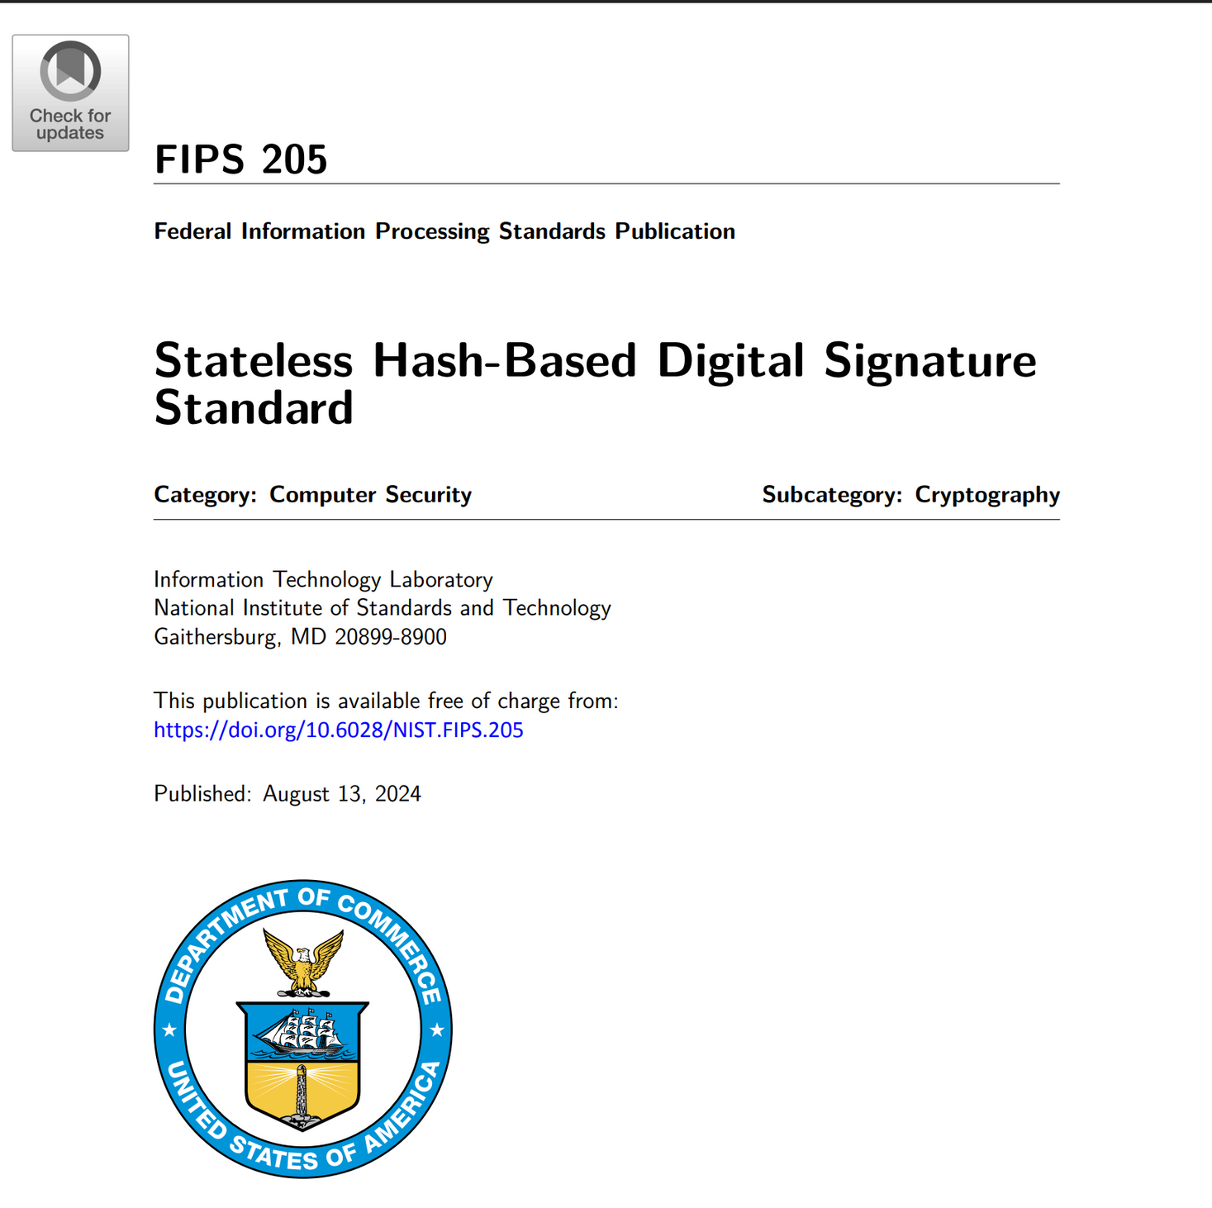
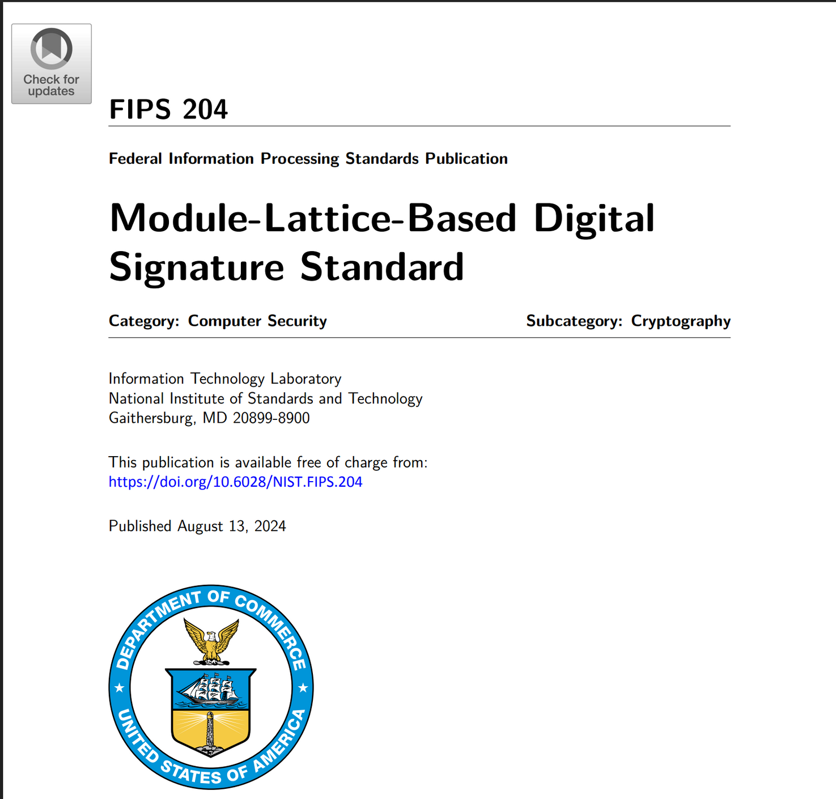
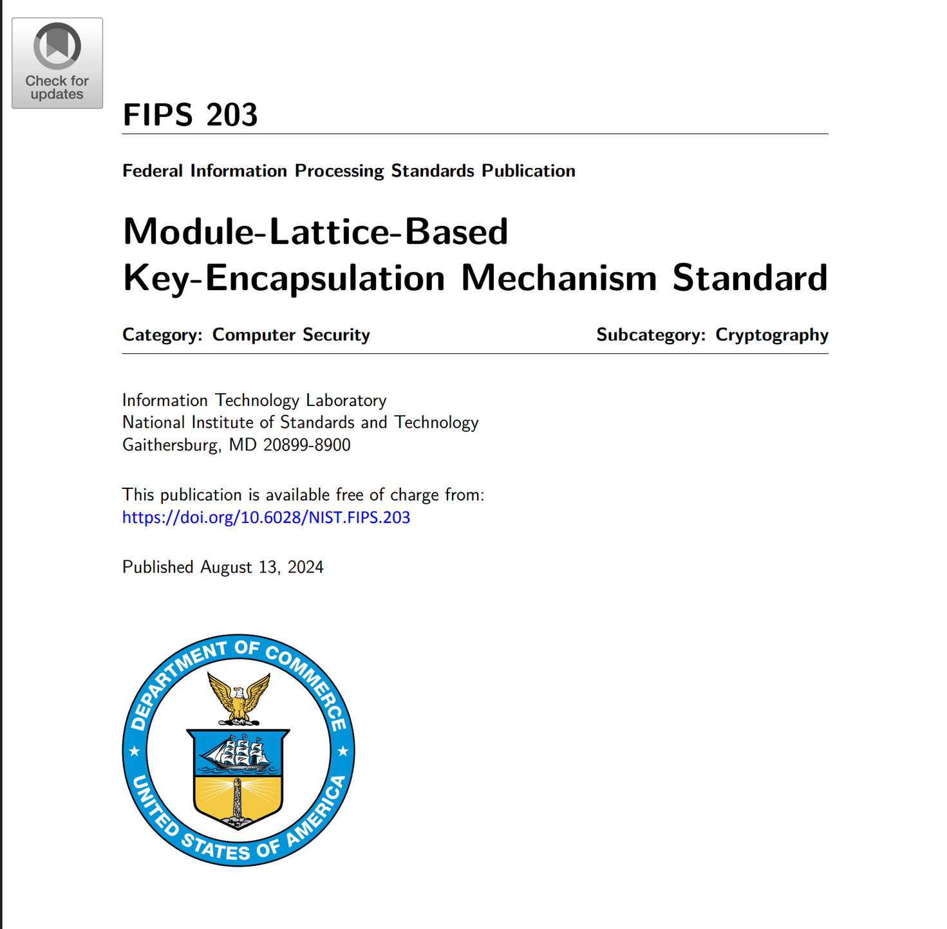
#MNSEC2025
Home
Short story
Longer story
NIST announced first PQC algorithms
In August 2024, NIST published 3 new FIPS standards.
FIPS 203: ML-KEM (Kyber)
FIPS 204: ML-DSA (Dilithium)
FIPS 205: SLH-DSA (SPHINCS+)
Coming soon
FIPS206: FN-DSA (FALCON)
TBD: HQC
#nist.gov
#NIST finalized PQC standards

Slide 21

#MNSEC2025
Home
Short story
Longer story
PQC algorithm types
  Hash based
  Lattice based
  Multi-variant based
  Isogeny based
  Code based
#pqc types

Slide 22
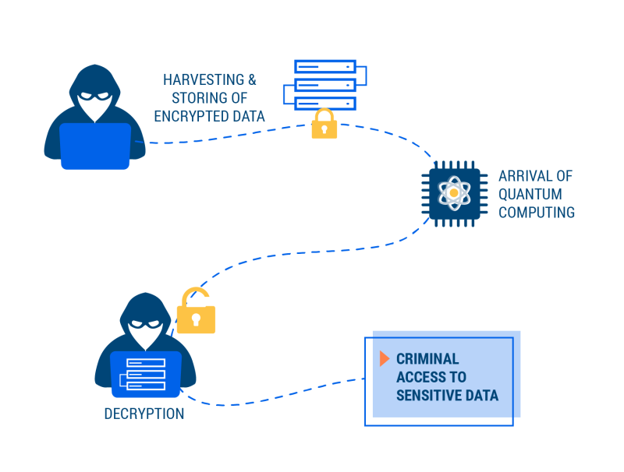
#MNSEC2025
Home
Short story
Longer story
Why do we need to act now?
Threat: “Store now decrypt later" (SNDL), also known as "harvest now, decrypt later," is a cybersecurity strategy where malicious actors collect encrypted data today with the intention of decrypting it in the future when advanced quantum computing capabilities become available to break current encryption methods like RSA and ECC
#store now, decrypt later #harvest now, decrypt later

Slide 23
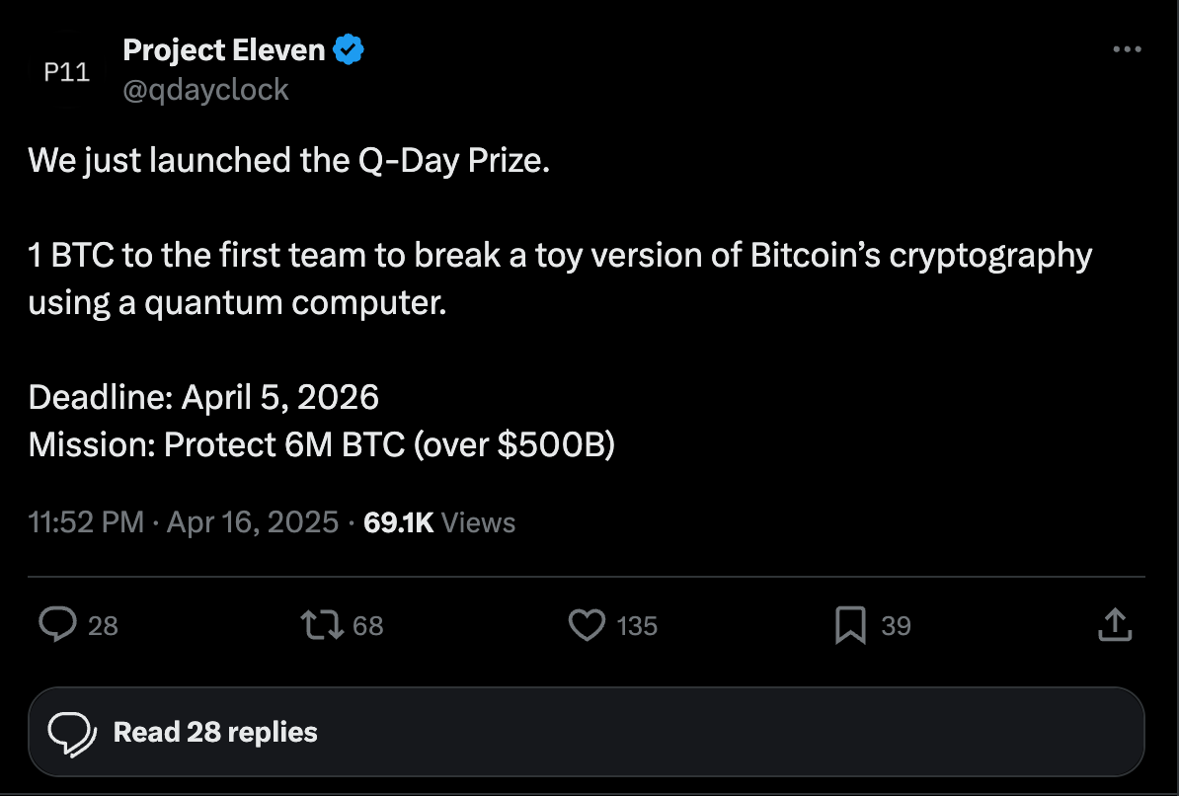
#MNSEC2025
Home
Short story
Longer story
Recent news #4
Everyone is seeking the solution!
#bitcoin q-day prize

Slide 24
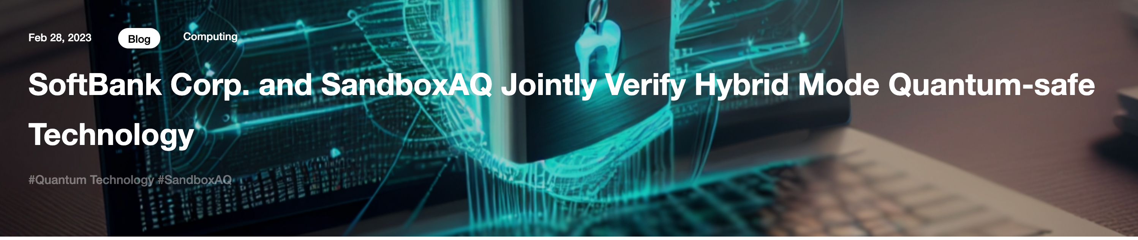
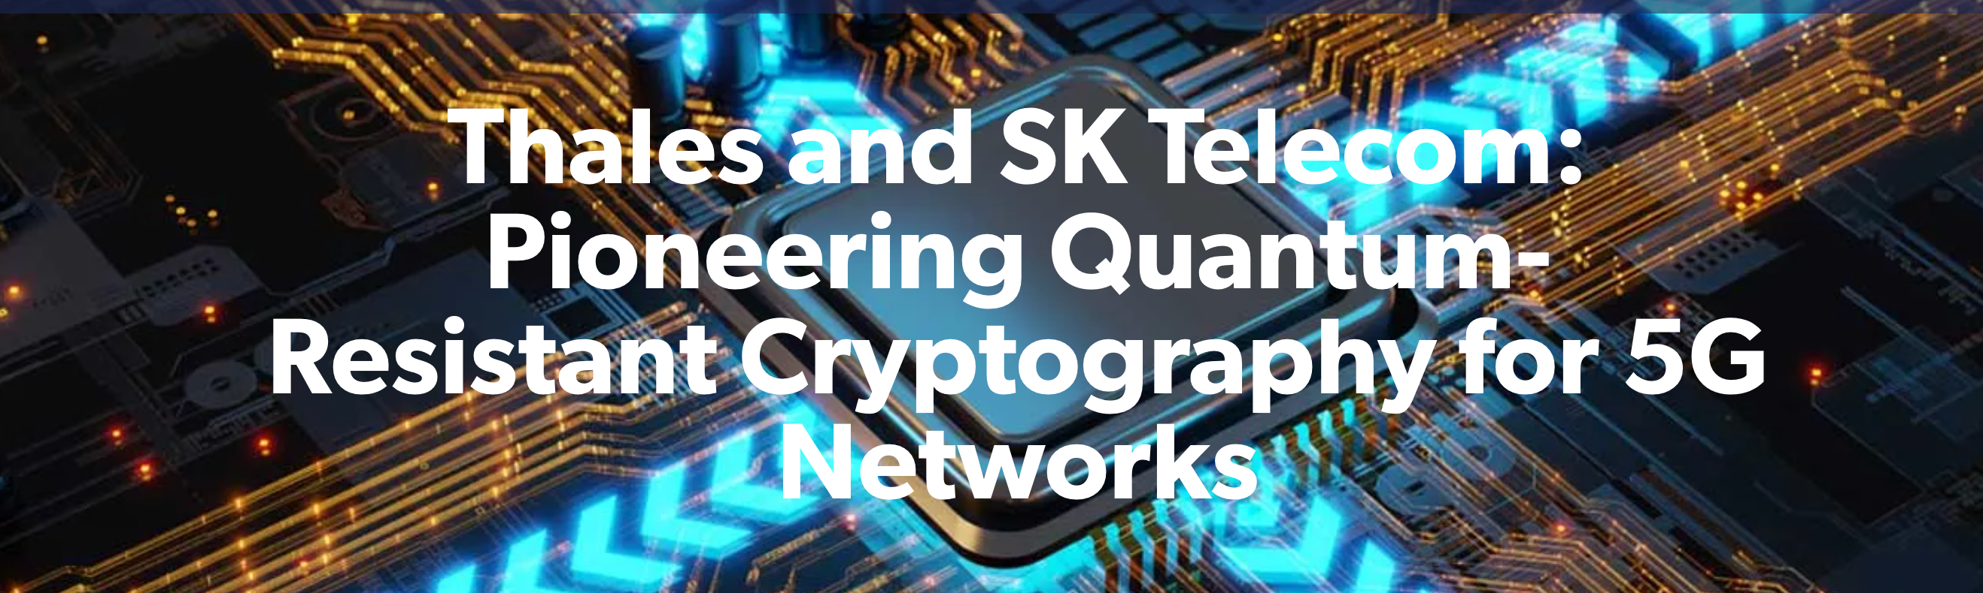
#MNSEC2025
Home
Short story
Longer story
Recent news #5
(Japan) SoftBank
https://www.softbank.jp/en/corp/technology/research/story-event/008/
(Korea) SK telecom
https://www.softbank.jp/en/corp/technology/research/story-event/008/
#Successfull implementations

Slide 25
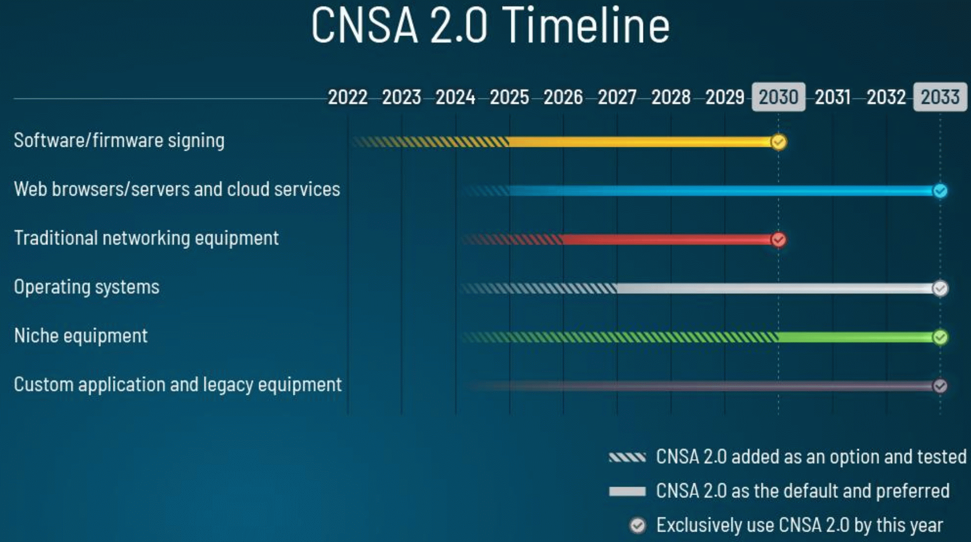
#MNSEC2025
Home
Short story
Longer story
NSA announced: Commercial National Security Algorithm Suite 2.0
#media.defense.gov
#NSA_CNSA_ 2.0_Algorithms

Slide 26
#MNSEC2025
Home
Short story
Longer story
How to select the correct PQC algorithms
Symmetric encryption
AES 128
AES 192
AES 256
AES 256
#CNSA 2.0

Slide 27
#MNSEC2025
Home
Short story
Longer story
How to select the correct PQC algorithms
Key establishment
DH
ECDH
RSA
ML-KEM
#CNSA 2.0

Slide 28
#MNSEC2025
Home
Short story
Longer story
How to select the correct PQC algorithms
ECDSA
RSA
DSA
Digital signing
used for code signing
No
stateful key possible
No
YES
security or speed more important
speed
security
ML-DSA
XMSS
LMS
#CNSA 2.0

Slide 29
#MNSEC2025
Home
Short story
Longer story
How to select the correct PQC algorithm
Hashing algorithms
SHA-1
SHA-256
SHA-384
SHA-512
SHA-384
SHA-512
#CNSA 2.0

Slide 30
#MNSEC2025
Home
Short story
Longer story
How to select the correct PQC algorithm
Hashing algorithms
SHA3-256
SHA3-384
SHA3-512
SHA3-384
SHA3-512
#CNSA 2.0

Slide 31
#MNSEC2025
Home
Short story
Longer story
Migration roadmap
Migration roadmap
  Assets and cryptography inventories
  Risk assessment
  Plan risk-oriented migration
  Migration execution
  Continuous research
Migration risks:
  Forgotten assets, dependencies
  No hardware
  New crypto vulnerabilities
  Standards updates and changes
#pqc migration roadmap
#nisduc.eu
#encryptionconsulting.com

Slide 32
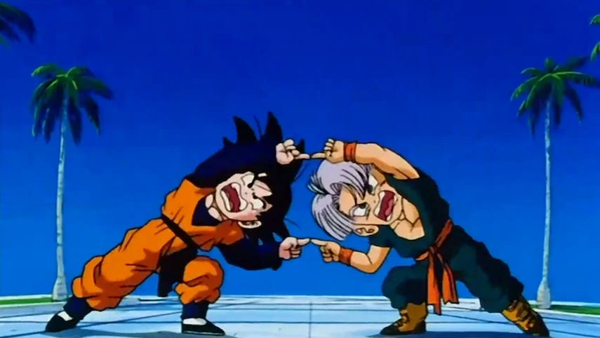
#MNSEC2025
Home
Short story
Longer story
Hybrid solution
Classic crypto
+
PQC crypto
#PQC hybrid mode

Slide 33
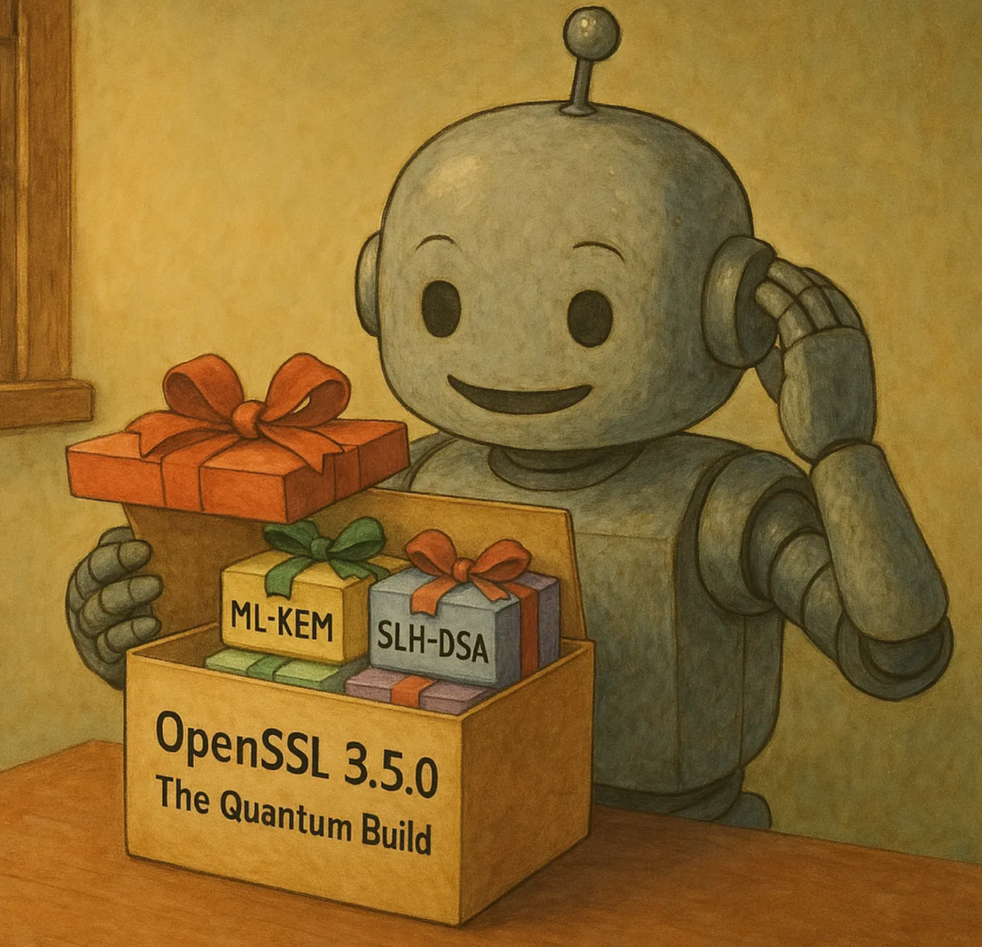
#MNSEC2025
Home
Short story
Longer story
How to use PQC, Hybrid algorithms
Hybrid Key Establishment:
  OpenSSH 10.0
  OpenSSL 3.5
  Web Browsers (not Safari)
  minor changes on web server`s config(apache, nginx ..)
Hybrid Digital Signature:
  update HSM
  update CA system
  OpenSSL 3.5
#post quantum cryptography
#github.com/open-quantum-safe

Slide 34
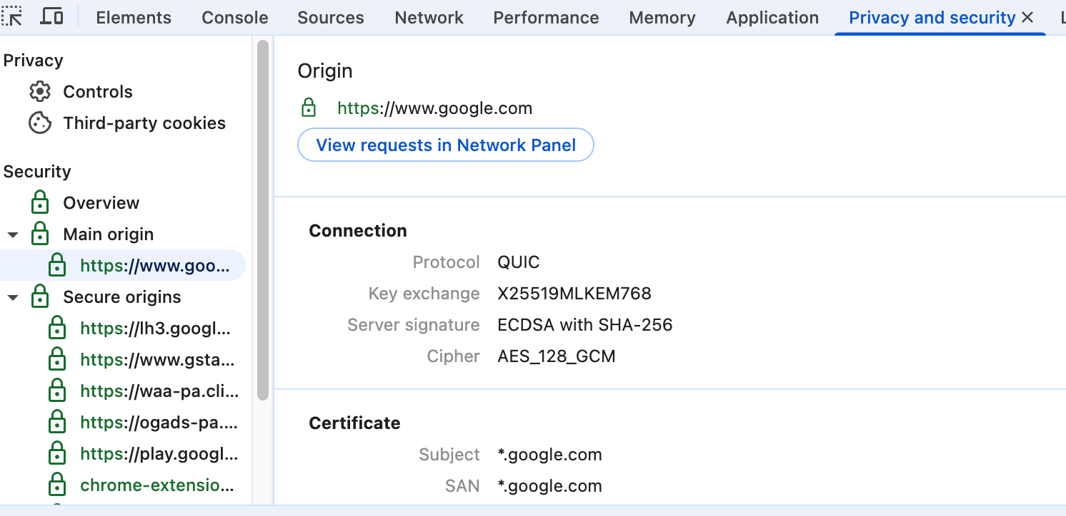
#MNSEC2025
Home
Short story
Longer story
Hybrid solution on TLS 1.3
#PQC hybrid TLS 1.3

Slide 35
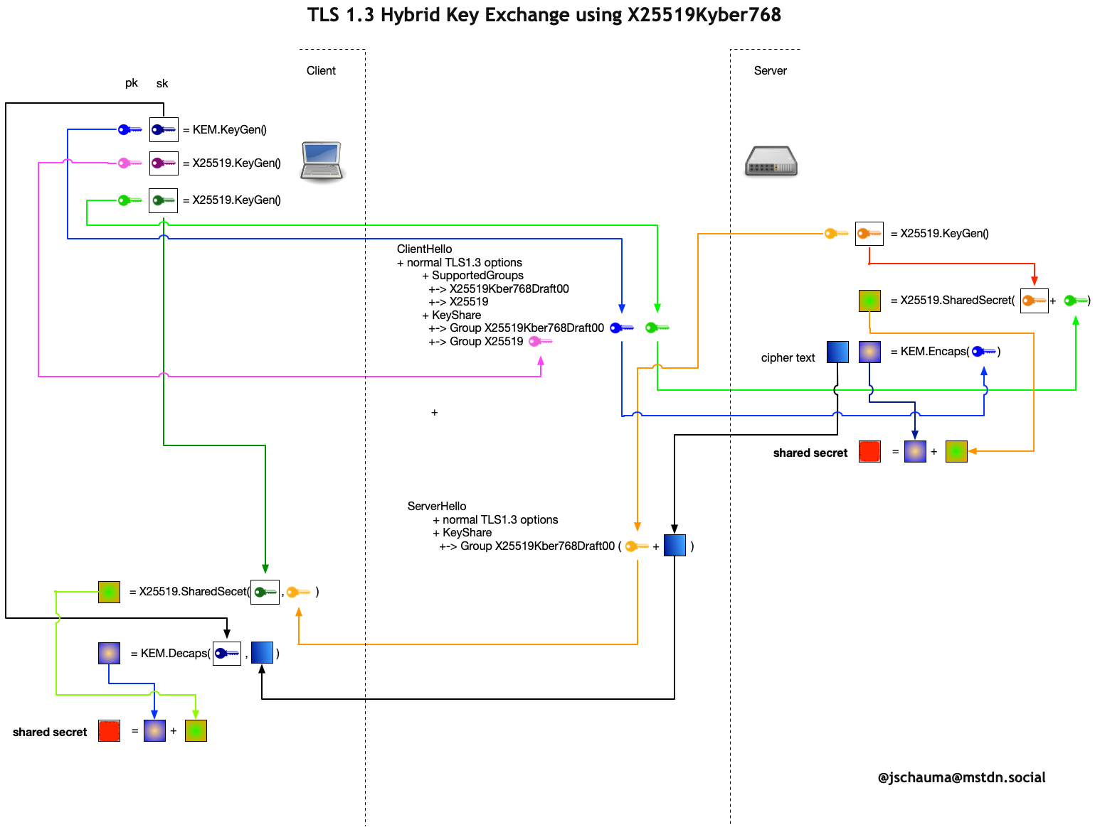
#MNSEC2025
Home
Short story
Longer story
Hybrid solution on TLS 1.3
#PQC hybrid TLS 1.3

Slide 36
#PQC hybrid TLS 1.3

Slide 37
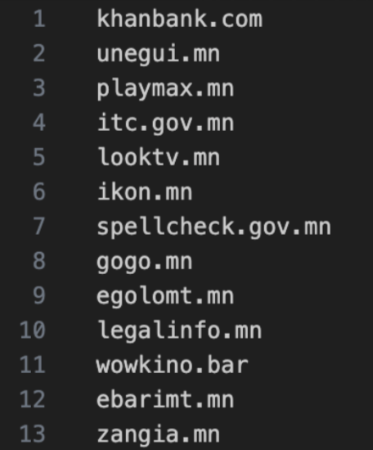
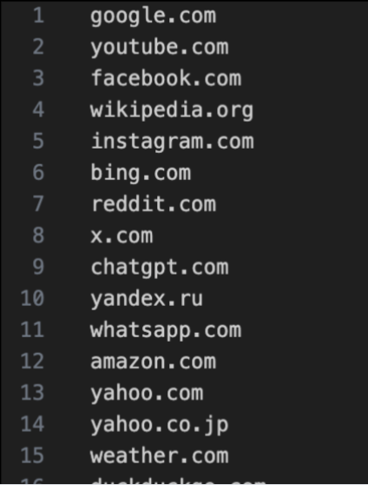
#MNSEC2025
Home
Short story
Longer story
Test: Sites using PQC
goal: Provide insights into how prepared major web platforms are
scope: Top 100 locally and globally visited websites
tools: Openssl + script
#sites using PQC
#netmeister.org

Slide 38
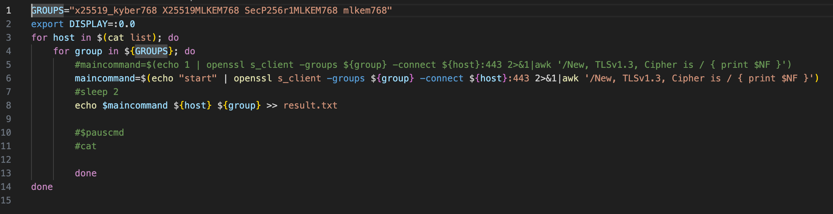
#MNSEC2025
Home
Short story
Longer story
Test: Sites using PQC
script:
#sites using PQC

Slide 39
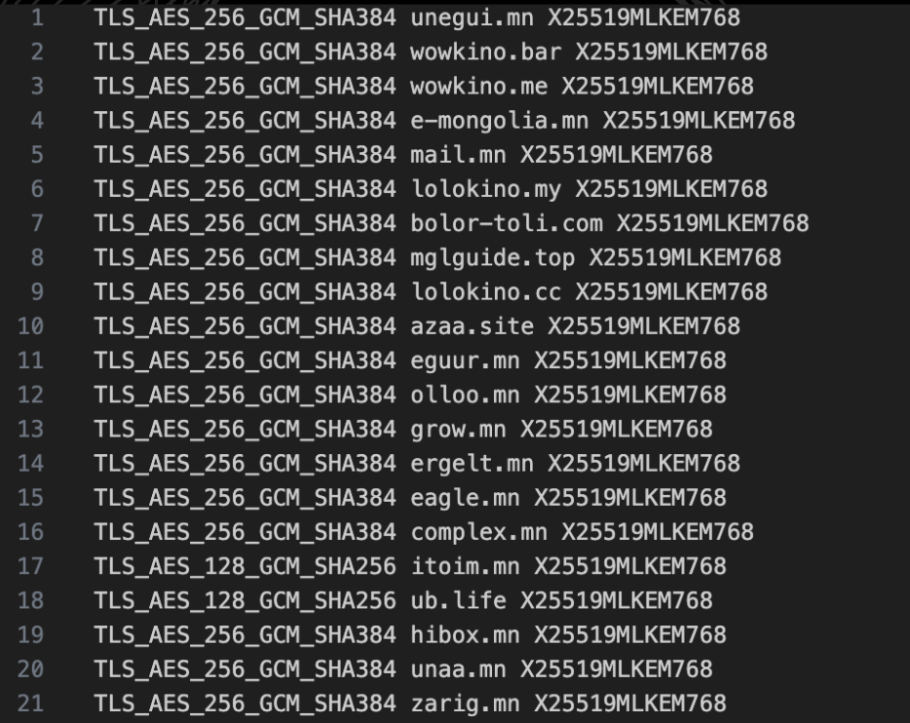
#MNSEC2025
Home
Short story
Longer story
Test: Sites using PQC
output:
#sites using PQC

Slide 40
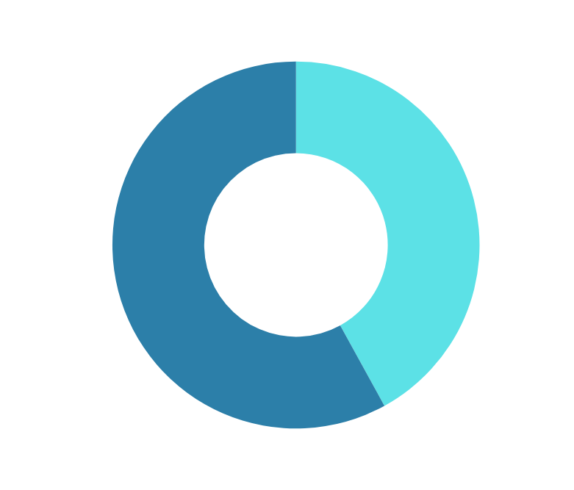

#MNSEC2025
Home
Short story
Longer story
Test: Sites using PQC
How prepared major web platforms are
Global
Mongolia
#sites using PQC

Slide 41


#MNSEC2025
Home
Short story
Longer story
Test: Sites using PQC
Which PQC algorithms are they using
Global
Mongolia
#sites using PQC

Slide 42
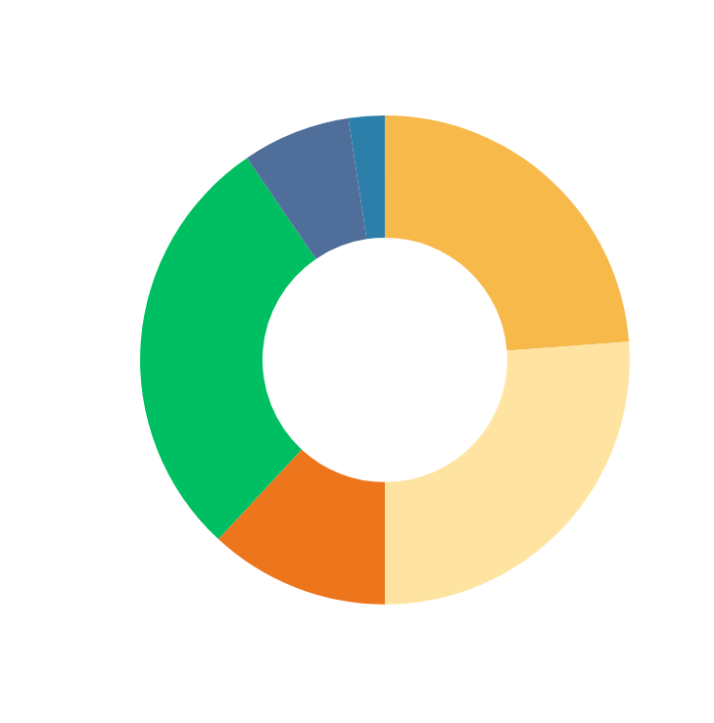
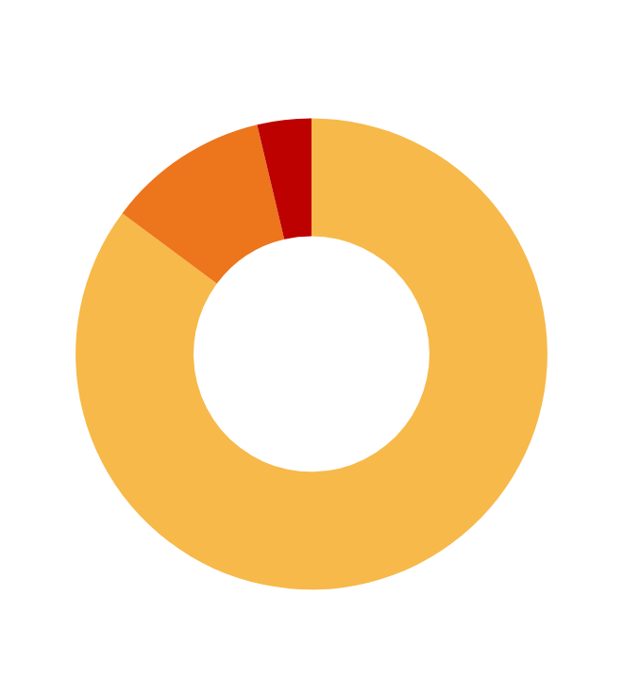
#MNSEC2025
Home
Short story
Longer story
Test: Sites using PQC
Which hosting provider are they using
Global
Mongolia
#sites using PQC

Slide 43
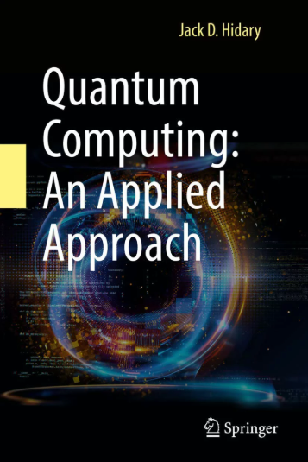
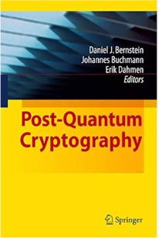
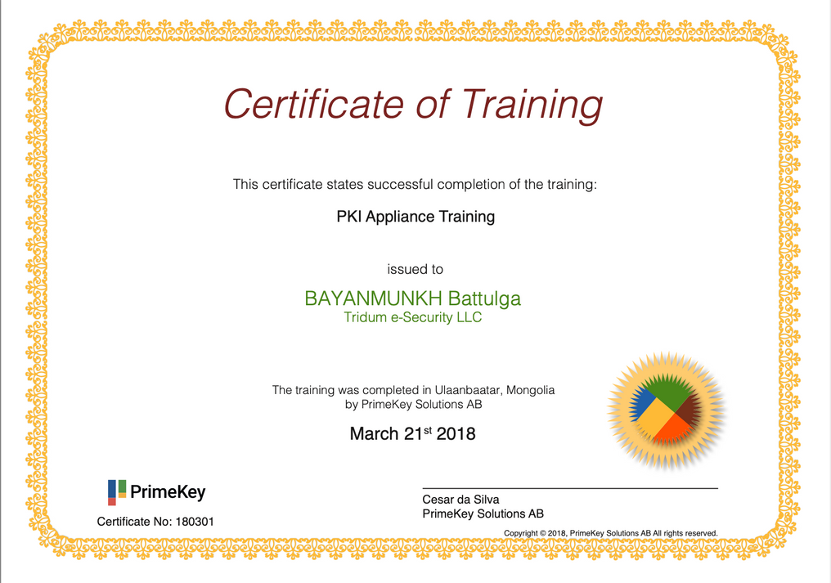
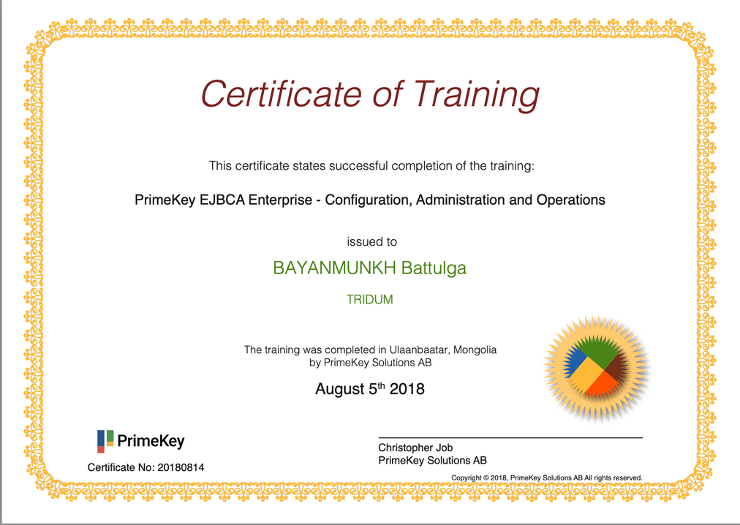
#MNSEC2025
Home
Short story
Longer story
#Reference list
Demo lab:
  Keyfactor PQC lab
Tools:
  Openssl, BoringSSL
Youtube:
  Quantum Village, Keyfactor, EJBCA
Research sites:
  Arxiv.org, netmeister.org

Slide 44

#MNSEC2025
Home
Short story
Longer story
Keyfactor PQC lab
https://www.keyfactor.com/post-quantum-cryptography-lab/

Slide 45

#MNSEC2025
Home
Short story
Longer story
Thank You
Have a wonderful Sunday!
-
linkedin.com/in/bayanmunkhb

